Slide 1
PPP Survey PPP Execution Example
Data Communication assignment #1-4 #1-5

Slide 2
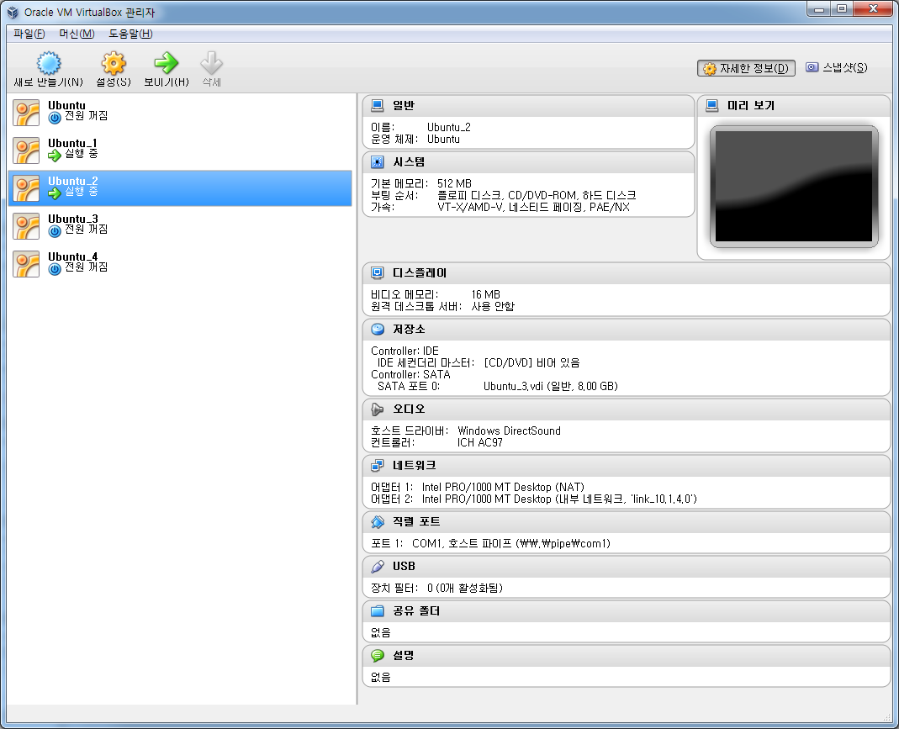
Setting Virtual Machine
Set up serial port in virtual machine
Need 2 VMs for communicate

Slide 3
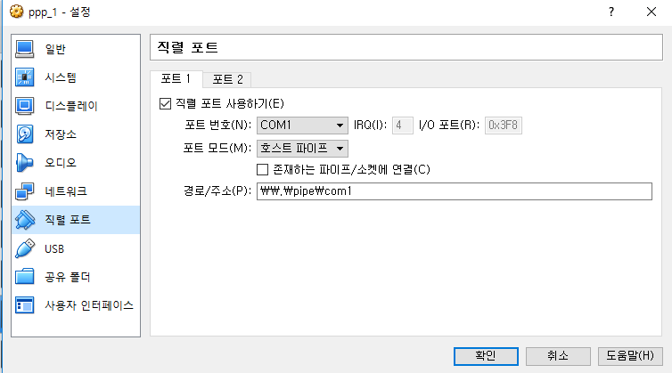
Serial Port Set Up in VM1
- 포트/파일 경로: \\.\pipe\com1으로 설정(1: 포트번호)
ex) 포트번호를 COM1로 설정, 포트/파일 경로 \\.\pipe\com1 로 설정
- vm1은 존재하는 파이프/소켓에 연결 체크 안함, vm2는 체크
- virtual machine 실행 시 존재하는 파이프/소켓에 연결을 체크하지 않은 vm부터 실행시켜야함
(즉 이 예제에선 vm1부터 실행시켜야 vm이 모두 켜짐)

Slide 4
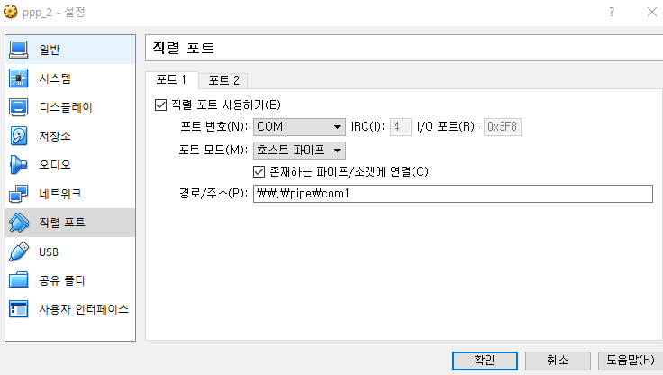
Serial Port Set Up in VM2

Slide 5
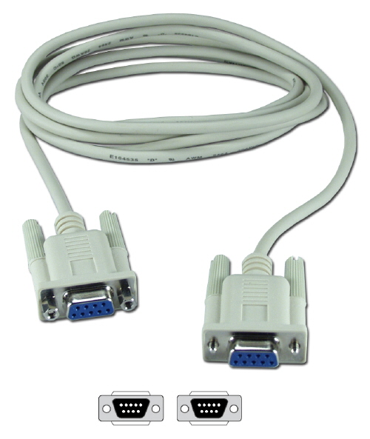
What is a Null Modem.
Null modem is a communication method to connect two DTEs
(computer, terminal, printer etc.) directly
using an RS-232 serial cable.

Slide 6
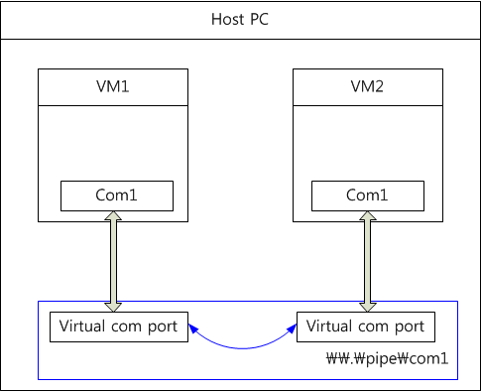
Null modem in virtual machine

Slide 7
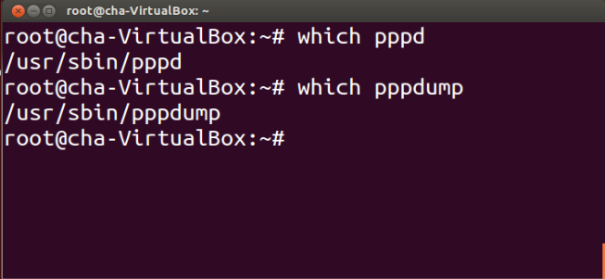
PPP Connection
Check PPP applications
$ which pppd
$ which pppdump
Install : # apt-get install ppp

Slide 8
pppd connection
Command format
Local IP : My IP address
Remote IP : Correspond IP address
ttyname : /dev/ttySx (x : port number)
record <path> : full path (ex : /root/test01)
Speed : 38400 (bps)
# pppd -detach crtscts lock debug record <path> noccp <local IP>:<remote IP> ttyname speed

Slide 9
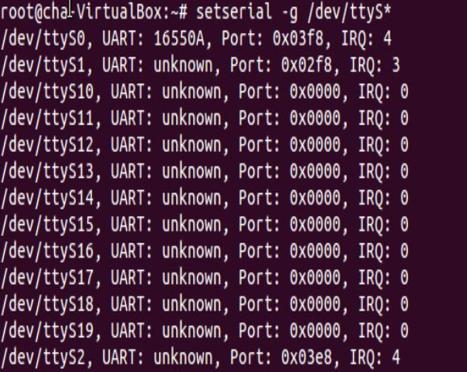
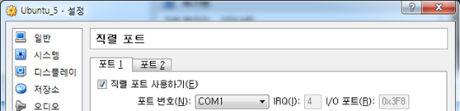
ttySx mapping
# setserial –g /dev/ttyS*

Slide 10
pppd command option
Command option
- option ($man pppd)
· crtscts: specifies that pppd should set the serial port to use h/w flow control.
· lock: specifies that pppd should create a UUCP-style lock file for the serial device
to ensure exclusive access to the device. By default, pppd will not create a lock
· debug: Enables connection debugging facilities. If this option is given, pppd will log the
contents of all control packets sent or received in a readable form.
· record <path>: Specifies that pppd should record all characters sent and received to
path
· <local IP>:<remote IP>: Set the local and/or remote interface Ip address.
· ttyname: Use the serial port called ttyname to communicate with the peer.
· speed: An option that is a decimal number is taken as the desired baud rate for the
serial device.
# pppd -detach crtscts lock debug record <path> noccp <local IP>:<remote IP> ttyname speed

Slide 11
pppd connection command
pppd execution
Terminal1 (VM1)
Terminal2 (VM2)
Same as terminal1, only swap local IP for remote IP
record /root/test01 : Set the path for dump file
# pppd -detach crtscts lock debug record /root/test02 noccp 10.1.3.10:10.1.3.20 /dev/ttyS0 38400
# pppd -detach crtscts lock debug record /root/test02 noccp 10.1.3.20:10.1.3.10 /dev/ttyS0 38400

Slide 12
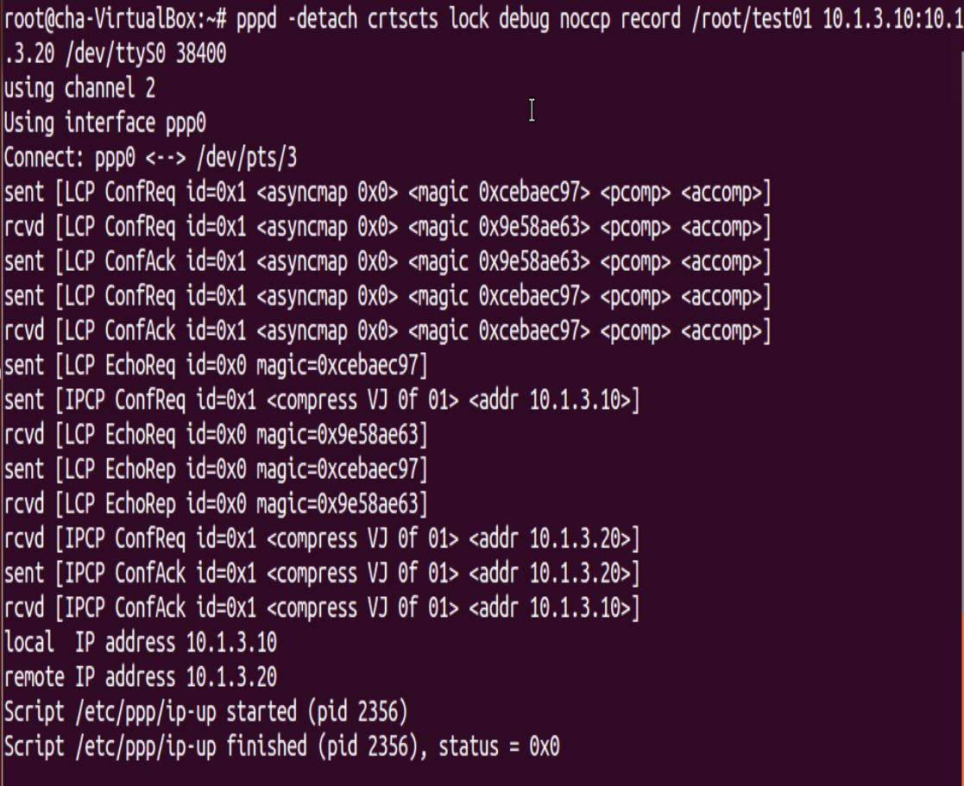
pppd connection example - debug

Slide 13
PPP frame analysis
Dump file output
#pppdump –h <path>
The pppdump utility converts the files written using the record option of pppd into a human-readable format.
path : /root/test01 or /root/test02

Slide 14
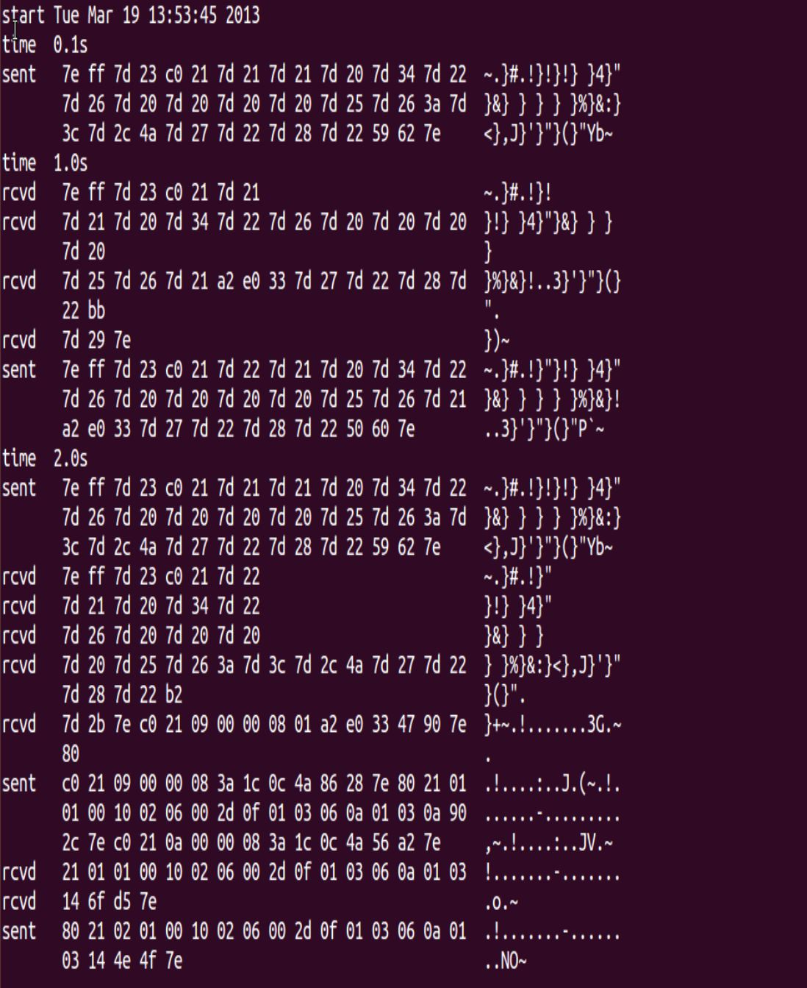
result of pppdump

Slide 15
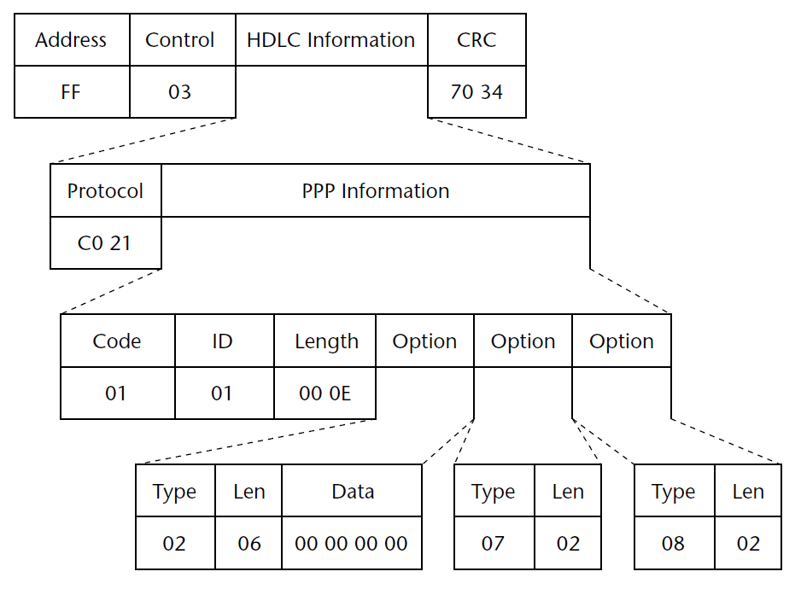
HDLC PPP LCP frame example

Slide 16
Frame Delimiter
Frame delimiter (flag)
A frame delimiter marks the end of one frame and the beginning of another. A frame delimiter at the end of a frame may also mark the start of the next frame.
The next frame is after an idle period
In case of continuous communication

Slide 17
Homework #1-4 (5)
pppd execution
Execute pppd following this command line
submission
Result screenshot
pppd connection debug output (like page 12)
Report
Explain PPP frame exchange order with reference to RFC documents.
pppd -detach crtscts lock debug noccp record /root/test01 <local IP>:<remote IP> /dev/ttyS0 38400

Slide 18
Homework #1-4 (5)
pppd 명령어를 사용하여 ppp configuration 과정을 pppd connection debug 화면을 기반으로 설명

Slide 19
Homework #1-5 (10)
Open pppdump packet
Result screenshot
pppdump output (like page 14)
Report
Analyze pppdump output to fit a frame format of PPP.
LCP frames, IPCP frames and Data frame (IPv4).

Slide 20
Homework #1-5 (10)
1. ppp 실행 후, pppdump 패킷 분석 (LCP, IPCP, IP Frame이 왜 해당 값을 갖는지)
모든 과제에는 반드시 결과 캡쳐화면을 첨부해주셔야합니다.

Slide 21
References
http://www.tldp.org/HOWTO/PPP-HOWTO/
http://linux.about.com/library/cmd/blcmdl8_pppdump.htm
RFC 1661, RFC 1662, RFC 1332
James Carlson, “PPP Design, Implementation, and Debugging 2nd edition,” Addison-Wesley, July 2000.

